Slide 1

IE 260 – ENGINEERING ECONOMY Chapter 9 Replacement Analysis
U. MAHİR YILDIRIM

Slide 2
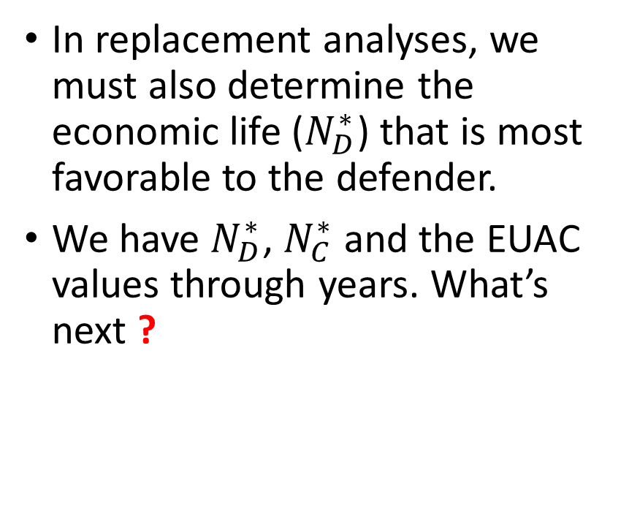
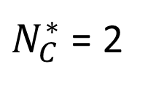
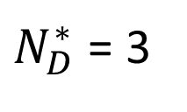
Determining the Economic Life Defender
In replacement analyses, we must also determine the economic life ($N_{D}^{∗}$) that is most favorable to the defender.
We have $N_{D}^{∗}$, $N_{C}^{∗}$ and the EUAC values through years. What’s next ?
Year | Defender | Challenger
1 | 4000 | 3600
2 | 3500 | 3000
3 | 2800 | 3100
4 | 3700 | 3300
$N_{D}^{∗}$ = 3
$N_{C}^{∗}$ = 2
Notes:
Defender

Slide 3
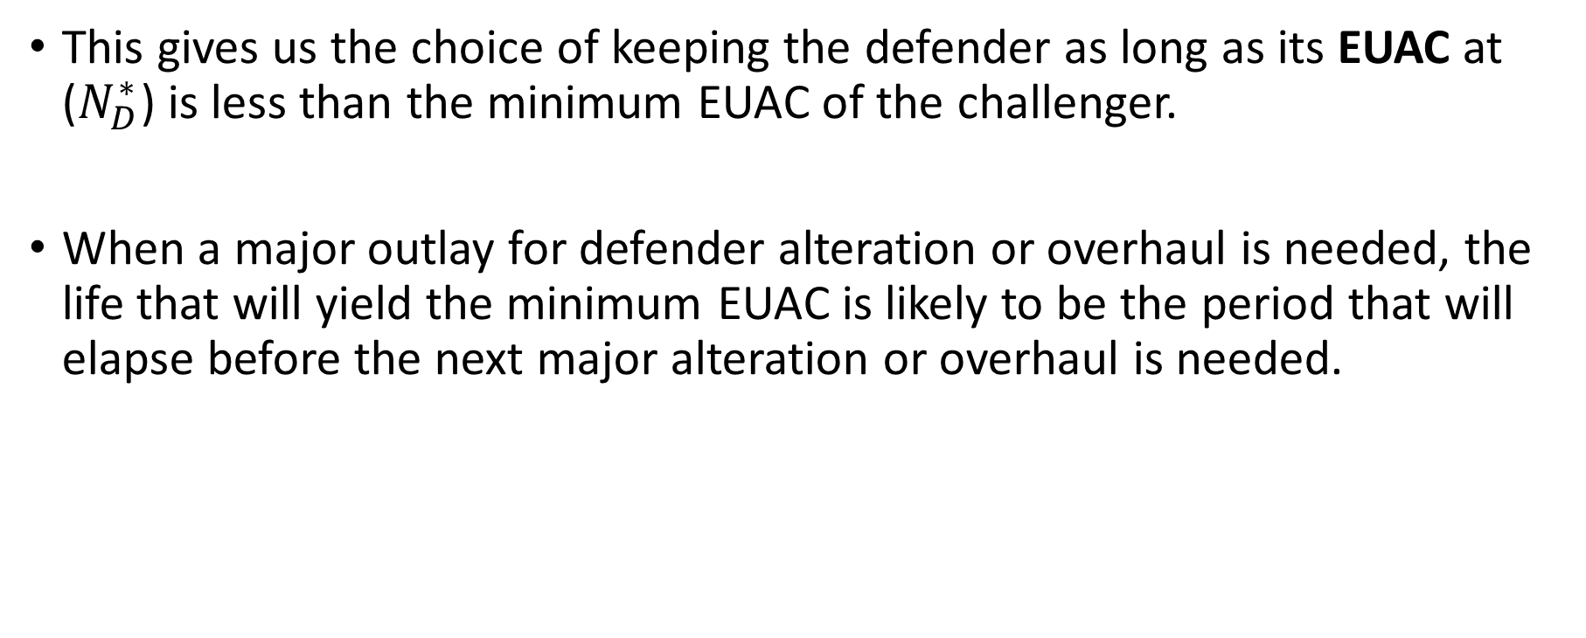
Determining the Economic Life Defender
This gives us the choice of keeping the defender as long as its EUAC at ($N_{D}^{∗}$) is less than the minimum EUAC of the challenger.
When a major outlay for defender alteration or overhaul is needed, the life that will yield the minimum EUAC is likely to be the period that will elapse before the next major alteration or overhaul is needed.
Notes:
Defender

Slide 4
Overhaul
Process of restoring and maintaining an equipment, machine, or system in a serviceable condition.
Overhaul involves
partial or complete disassembly of the item,
inspection to detect damaged, defective, or worn parts,
repair or replacement of such parts, and
reassembly, testing, and trial-run prior to returning the item to its full operating level.

Slide 5
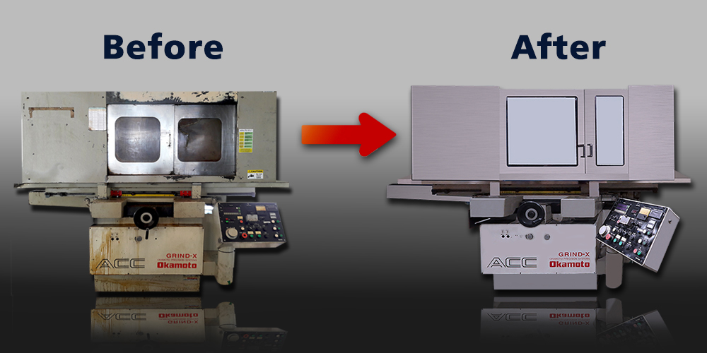
Overhaul (cont'd)
CNC spindle overhaul example
https://www.youtube.com/watch?v=VQsvyfoXr-I
V8 engine overhaul example (timelapse)
https://www.youtube.com/watch?v=W5saoYQIlh8

Slide 6
Determining the Economic Life Defender
Alternatively, when there is no defender MV now or later (and no outlay for alteration or overhaul) and when the defender’s operating expenses are expected to increase annually, the remaining life that will yield the minimum EUAC will be ?
When MVs are greater than zero and expected to decline from year to year, it is necessary to calculate the apparent remaining economic life, which is done in the same manner as for a new asset. Using the outsider viewpoint, the investment value of the defender is considered to be its present realizable MV.
1 year.

Slide 7
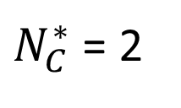
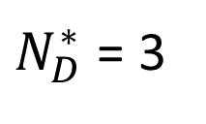
Determining the Economic Life Defender
Regardless of how the remaining economic life for the defender is determined, a decision to keep the defender does not mean that it should be kept only for this period of time.
Year | Defender | Challenger
1 | 4000 | 3600
2 | 3500 | 3000
3 | 2800 | 3100
4 | 3700 | 3300
$N_{D}^{∗}$ = 3
$N_{C}^{∗}$ = 2

Slide 8
Determining the Economic Life Defender
Indeed, the defender should be kept longer than the apparent economic life as long as its marginal cost* is less than the minimum EUAC for the best challenger.
*total cost for an additional year of service

Slide 9
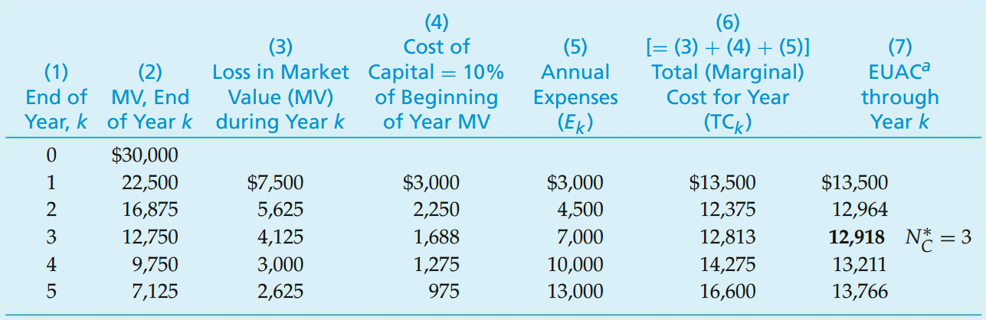
Recall Example Economic Life of a Challenger (New Asset)
A new forklift truck will require an investment of $30,000 and is expected to have year-end MVs and annual expenses as shown on the right. If the before-tax MARR is 10% per year, how long should the asset be retained in service?

Slide 10
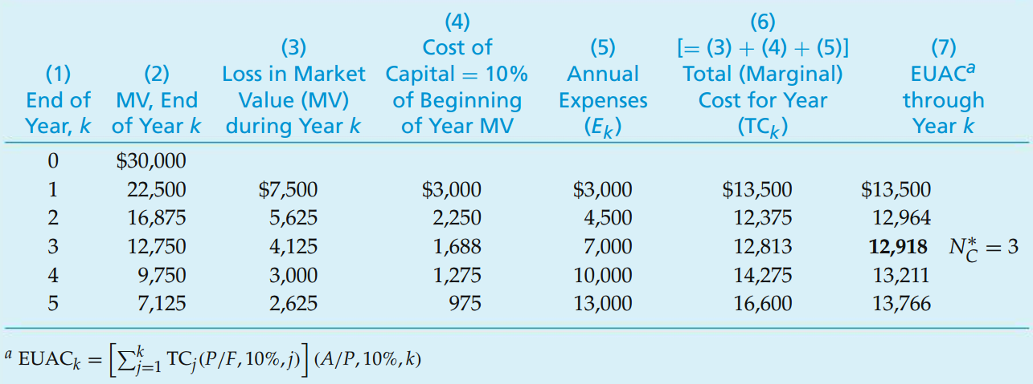
Recall Solution Economic Life of a Challenger (New Asset)

Slide 11
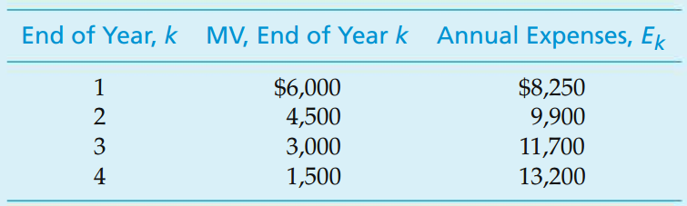
Example Economic Life of a Defender (Existing Asset)
It is desired to determine how much longer a forklift truck should remain in service before it is replaced by the new truck (challenger) in the previous example.
The defender in this case is two years old, originally cost $19,500, and has a present realizable MV of $7,500. If kept, its MVs and annual expenses are expected to be as follows:
Determine the most economical period to keep the defender before replacing it (if at all) with the present challenger. The before-tax cost of capital (MARR) is 10% per year.

Slide 12
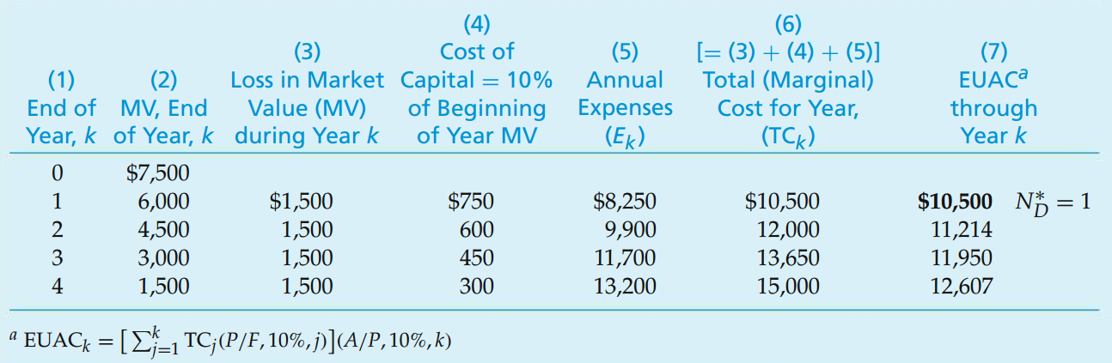
Solution Economic Life of a Defender (Existing Asset)

Slide 13
Solution Economic Life of a Defender (Existing Asset)
Recall that the minimum EUAC for the challenger was $12,918 with an economic life of 3 years.
What is the decision?
What is the decision for the 2nd year?
What is the decision for the 3rd year?

Slide 14
Solution Economic Life of a Defender (Existing Asset)
Note that the minimum EUAC of $10,500 corresponds to keeping the defender for one more year.
The marginal cost of keeping the truck for the second year is, however, $12,000, which is still less than the minimum EUAC for the challenger ($12,918 from previous example)
12,000 vs 12,918 ?

Slide 15
Solution Economic Life of a Defender (Existing Asset)
The marginal cost for keeping the defender the third year and beyond is greater than the $12,918 minimum EUAC for the challenger (13,650 > 12,918 )
Based on the available data shown, it would be most economical to keep the defender for two more years and then to replace it with the challenger

Slide 16
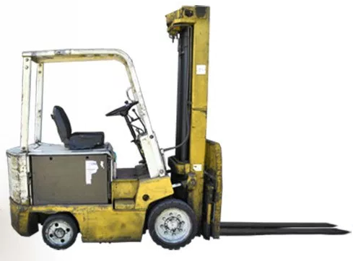
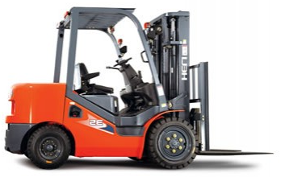
Solution Economic Life of a Defender (Existing Asset)
Year
Forklift
Annual Cost
1
10,500
2
12,000
3
12,918
Challenger
4
12,918
Defender
5
12,918

Slide 17
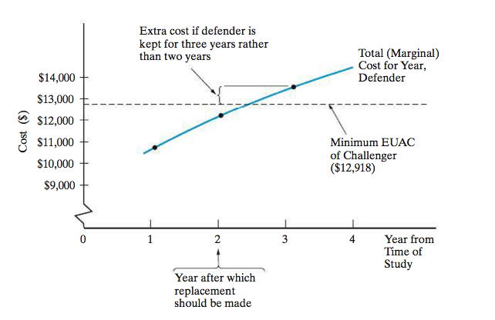
Solution – Graphical Representation Economic Life of a Defender (Existing Asset)

Slide 18
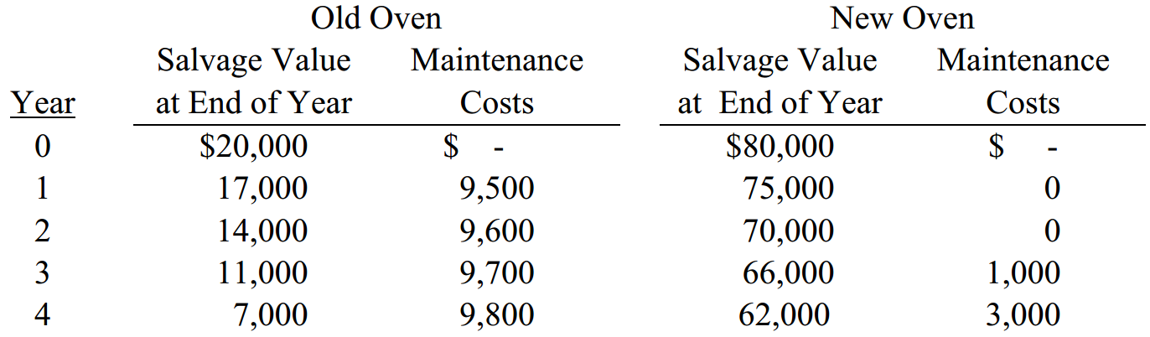
Example Replacement Analysis at a Bakery
One of the four ovens at a bakery is being considered for replacement. A new oven costs $80,000 and this price includes a complete guarantee of the maintenance costs for the first two years, and it covers a good proportion of the maintenance costs for years 3 and 4. The market value and maintenance costs are summarized in the table.
Both the old and new ovens have similar productivities and energy costs. When should the oven be replaced, if the MARR equals 10%?
Market
Market

Slide 19
Solution Replacement Analysis at a Bakery
The old oven (“defender”)
*Economic life = 3 years, with EUAC = $14,312.60
EOY | MV – EOY k | Loss in MV during year k | Cost of Capital (10%) | Annual Expenses (E_{k}) | Total Marginal Cost (TC_{k}) | EUAC through year k
0 | 20,000
1 | 17,000 | 3,000 | 2,000 | 9,500 | 14,500 | 14,500.0
2 | 14,000 | 3,000 | 1,700 | 9,600 | 14,300 | 14,404.8
3 | 11,000 | 3,000 | 1,400 | 9,700 | 14,100 | 14,312.6 *
4 | 7,000 | 4,000 | 1,100 | 9,800 | 14,900 | 14,439.6

Slide 20
Solution Replacement Analysis at a Bakery
The new oven (“challenger”)
*Economic life = 3 years, with EUAC = $12,531.50
Final decision:
Since EUAC defender > EUAC challenger (14,312.6 > 12,531.5) replace oven this year.
EOY | MV – EOY k | Loss in MV during year k | Cost of Capital (10%) | Annual Expenses (E_{k}) | Total Marginal Cost (TC_{k}) | EUAC through year k
0 | 80,000
1 | 75,000 | 5,000 | 8,000 | - | 13,000 | 13,000.0
2 | 70,000 | 5,000 | 7,500 | - | 12,500 | 12,762.0
3 | 66,000 | 4,000 | 7,000 | 1,000 | 12,000 | 12,531.5 *
4 | 62,000 | 4,000 | 6,600 | 3,000 | 13,600 | 12,762.6

Slide 21
End of Chapter 9

